Slide 1
Visualizing distributions
HUGEN 2073
Genomic Data Visualization and Integration
Slides borrowed/adapted from H. J. Park with permission

Slide 2
Topics
Visualizing
Distributions of single variable
Distributions of multiple variables
Statistical properties underlying a distribution
Notes:
Today, we will discuss another component of visualization, color.
After that, we will briefly discuss how to visualize amount, distributions, and proportions.

Slide 3
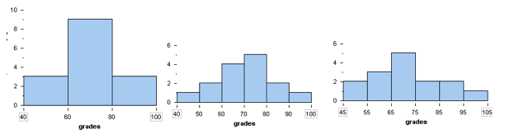
Histograms for the distribution of 1 variable
X-axis: bins (of a continuous variable)
Y-axis: # of items in the bin
Name | Grade
Adams | 10
Baker | 2
Clark | 34
Davis | 24
Evans | 45
Frank | 6
Ghosh | 53
Hills | 81
Irwin | 21
Jones | 52
Klein | 36
Lopez | 15
…. | …
Notes:
A great way to get started exploring a single variable is with the histogram. A histogram divides the variable into bins, counts the data points in each bin, and shows the bins on the x-axis and the counts on the y-axis. In our case, the bins will be an interval of time representing the delay of the flights and the count will be the number of flights falling into that interval.
https://courses.lumenlearning.com/wmopen-concepts-statistics/chapter/histograms-2-of-4/

Slide 4
Bin width is the most important parameter
What bin width (and position) would be best here?
A “good” bin width may give a more direct interpretation
Notes:
https://courses.lumenlearning.com/wmopen-concepts-statistics/chapter/histograms-2-of-4/

Slide 5
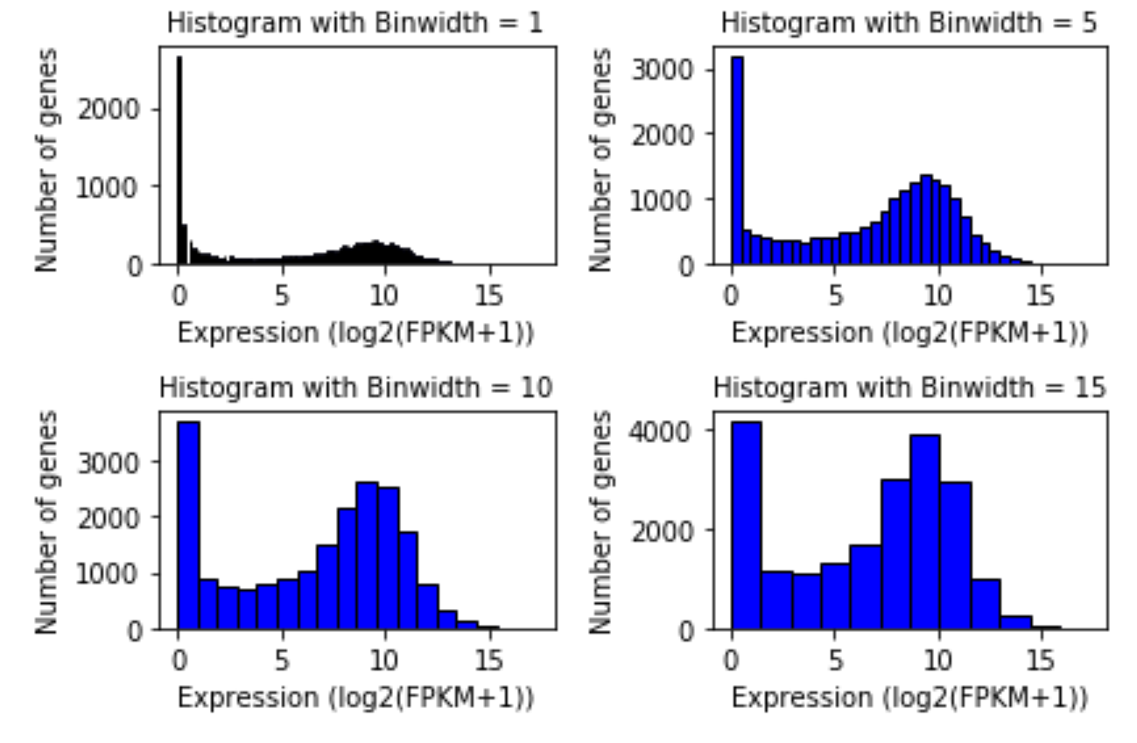
Bin width is the most important parameter
Informative bin width
Gives direct interpretation
May conform to context-specific prior knowledge (e.g. the ratio of lowly expressed genes to other genes)
Default is not necessarily best!

Slide 6
Distribution of a single variable in a table
Gene/sample | TCGA-BH-A0C7-01
ARHGEF10L | 10.0931
HIF3A | 3.609
RNF17 | 0
RNF10 | 11.382
RNF11 | 10.7663
RNF13 | 10.3366
GTF2IP1 | 12.724
REM1 | 2.2163
MTVR2 | 0.334
RTN4RL2 | 5.091
C16orf13 | 8.6721
C16orf11 | 0
FGFR1OP2 | 8.6967
TSKS | 0.605
ATRX | 10.7342
PMM2 | 9.7939
LOC100272146 | 5.2176
ASS1 | 8.1664
NCBP1 | 10.8287
ZNF709 | 7.5449
ZNF708 | 7.1908
RBM14 | 9.9606
NCBP2 | 10.9786
DISC1 | 6.3806
CAMK1 | 8.0451
RPL37 | 12.619
E.g., expression (FPKM) for 20,530 genes in the breast tumor sample TCGA-BH-A0C7-01
×20,530
……

Slide 7
Histogram of the same expression data
Gene/sample | TCGA-BH-A0C7-01
ARHGEF10L | 10.0931
HIF3A | 3.609
RNF17 | 0
RNF10 | 11.382
RNF11 | 10.7663
RNF13 | 10.3366
GTF2IP1 | 12.724
REM1 | 2.2163
MTVR2 | 0.334
RTN4RL2 | 5.091
C16orf13 | 8.6721
C16orf11 | 0
FGFR1OP2 | 8.6967
TSKS | 0.605
ATRX | 10.7342
PMM2 | 9.7939
LOC100272146 | 5.2176
ASS1 | 8.1664
NCBP1 | 10.8287
ZNF709 | 7.5449
ZNF708 | 7.1908
RBM14 | 9.9606
NCBP2 | 10.9786
DISC1 | 6.3806
CAMK1 | 8.0451
RPL37 | 12.619
Distribution of FPKM values of 20,530 genes from breast tumor sample
×20,530
# genes
……
FPKM
Notes:
Histogram is a type of barplot showing data distribution.
In this figure, x-axis indicates the range of FPKM values in each bin and y-axis indicates the number of genes whose FPKM values fall within the range.
For example, there are >12K genes …
At the same time we check a figure, we accept a set of assumptions they make some of them for their own convenience.
Their value categorization and the scale.
More importantly, there is a skewness favoring lower values with a long tail.
Apprently, it is not Gaussian
This skewness deter us from focusing on the high signal regions.

Slide 8
Histogram on logarithmic scale to visualize non-Gaussian distribution
Distribution of FPKM values of 20,530 genes from breast tumor sample
Nonlinear x-axis of log2(FPKM+1)
Why +1?
# genes
Log2(FPKM+1)
Notes:
At the same time we check a figure, we accept a set of assumptions they make some of them for their own convenience.
More importantly, there is a skewness.

Slide 9
Making a histogram
In ggplot
geom_histogram has several ways you can control the bins
binwidth = width of bins (can get fancy here)
bins = number of bins
breaks = a vector giving the bin boundaries
position (how to arrange the bars of multiple overlaid histograms)
aesthetics are like those for geom_bar, including
x or y
fill
color
Notes:
Always check your values at least initial ones
https://towardsdatascience.com/histograms-and-density-plots-in-python-f6bda88f5ac0

Slide 10
Choosing a bin width
With wider bins…
broader patterns
diluted noise
lose patterns in small intervals
Notes:
But eventually, it is up to you.

Slide 11
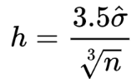
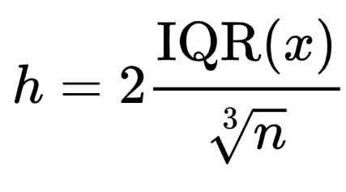
Bin width can be determined based on formulas
Scott's normal
reference rule
Freedman-Diaconis’ choice
We want to use too wide a bin width (i.e., less sensitive a bin width)
You don’t have to remember these, because they are provided (e. g., n.bins(x, rule=c("freedman.diaconis", "sturges", "scott", "simple") in R)
I prefer to test and see by myself to make it informative

Slide 12
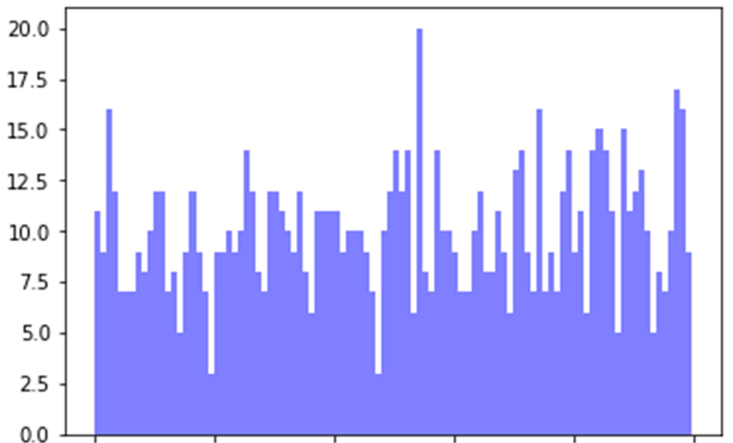
Axes should be appropriate
E. g., this system produces values between 0 and 1
# cases
0
0.2
0.4
0.6
0.8
1.0
Notes:
It’s like saying that your x-axis can be 1.25 in the system you’re representing.
However, it does not make sense if it’s percentage value.
So, your figure in current form is wrong.

Slide 13
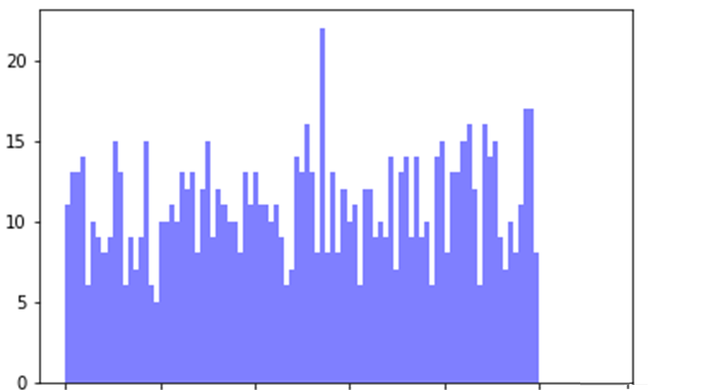
Axes should conform to the range of the variable
This system apparently produces (could produce?) values between 0 and 1.2
So are the values between 1 and 1.2 missing?
# cases
0
0.2
0.4
0.6
0.8
1.0
1.2
Notes:
It’s like saying that your x-axis can be 1.25 in the system you’re representing.
However, it does not make sense if it’s percentage value.
So, your figure in current form is wrong.

Slide 14
The distribution of 2+ variables
……
sample | TCGA-AR-A5QQ-01 | TCGA-BH-A0C7-01
ARHGEF10L | 9.5074 | 10.0931
HIF3A | 1.5787 | 3.609
RNF17 | 0 | 0
RNF10 | 11.3676 | 11.382
RNF11 | 11.1292 | 10.7663
RNF13 | 9.9722 | 10.3366
GTF2IP1 | 11.5966 | 12.724
REM1 | 3.2396 | 2.2163
MTVR2 | 0 | 0.334
RTN4RL2 | 3.5764 | 5.091
C16orf13 | 9.794 | 8.6721
C16orf11 | 0.5819 | 0
FGFR1OP2 | 8.844 | 8.6967
TSKS | 1.993 | 0.605
ATRX | 9.4263 | 10.7342
PMM2 | 10.3735 | 9.7939
LOC100272146 | 3.0792 | 5.2176
ASS1 | 9.5279 | 8.1664
NCBP1 | 10.3001 | 10.8287
ZNF709 | 5.2763 | 7.5449
ZNF708 | 6.3037 | 7.1908
RBM14 | 10.3336 | 9.9606
NCBP2 | 10.8729 | 10.9786
DISC1 | 6.0783 | 6.3806
CAMK1 | 8.6979 | 8.0451
Expression (FPKM) for 20,530 expressed genes in two breast tumor samples (TCGA-BH-A0C7-01, TCGA-AR-A5QQ-01, …)
……

Slide 15
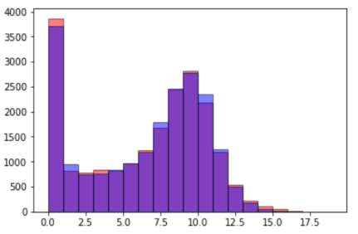
Overlapped histogram for two variables?
Need to set
the same bin width starting at the same x-axis points
transparency
Problems
Comparisons difficult?
3 colors now
Looks stacked
# genes
Log2(FPKM+1)
Notes:
By defining one figure with two histograms with transparency parameter, you can have put histogram on top of each other.
This plot is not very helpful! All the overlapping bars make it nearly impossible to make comparisons between the airlines. Let’s look at a few possible solutions to this common problem.

Slide 16
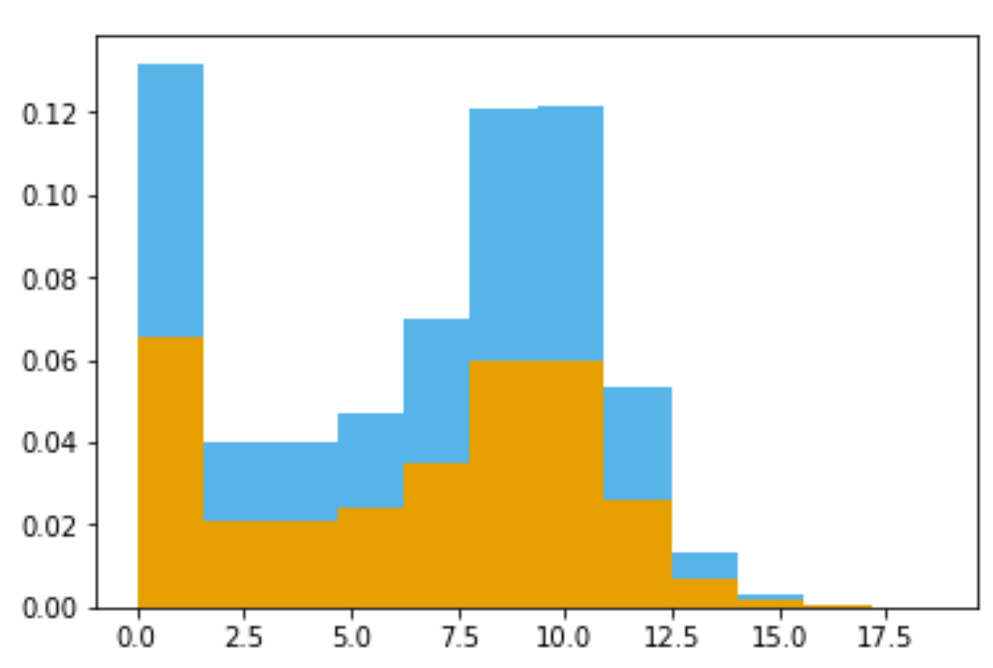
Stacked histogram for two variables?
As a proportion of the whole for each bin → counts are not shown!
Still not easy to compare between colors
Confusing – not clear whether these are stacked or overlapped!
Normalized # genes
Log2(FPKM+1)
Notes:
Well, that definitely is not any better! Here, each sample is represented as a section of the whole for each bin, but it’s nearly impossible to make comparisons. For example, in the first bar, yellow have a larger size of the bar? I can’t tell and viewers won’t be able to either. I generally am not a proponent of stacked bars because they can be difficult to interpret. Both of the solutions we tried using histograms were not successful.
It is confusing in that the bars do not overlap in this case.
To distinguish a figure with overlap from this, the figure with overlap should use transparent colors.

Slide 17
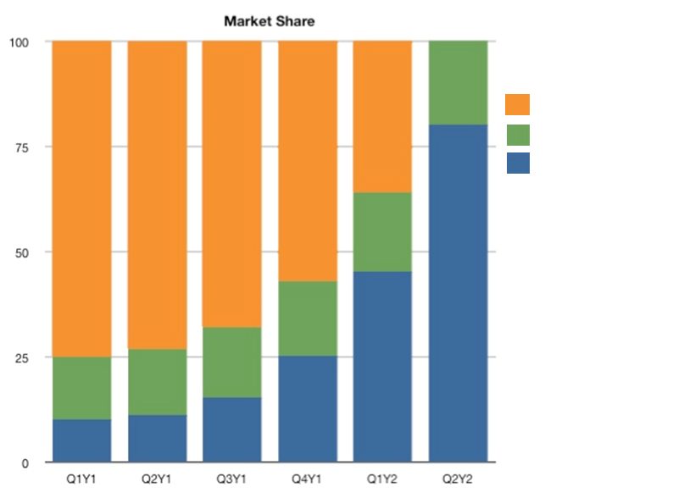
Stacked histogram?
Sample as a proportion of the whole for each bin for comparison
Maybe OK when the total amount is fixed
Still has the problems of a stacked bar plot/area plot
Timeline of the change in market share
Company
A
B
C
Normalized # genes
Market share (%)
Log2(FPKM+1)
http://www.leancrew.com/all-this/2011/11/i-hate-stacked-area-charts/
Notes:
Well, that definitely is not any better! Here, each sample is represented as a section of the whole for each bin, but it’s nearly impossible to make comparisons. For example, in the first bar, yellow have a larger size of the bar? I can’t tell and viewers won’t be able to either. I generally am not a proponent of stacked bars because they can be difficult to interpret. Both of the solutions we tried using histograms were not successful.
It is confusing in that the bars do not overlap in this case.
To distinguish a figure with overlap from this, the figure with overlap should use transparent colors.

Slide 18
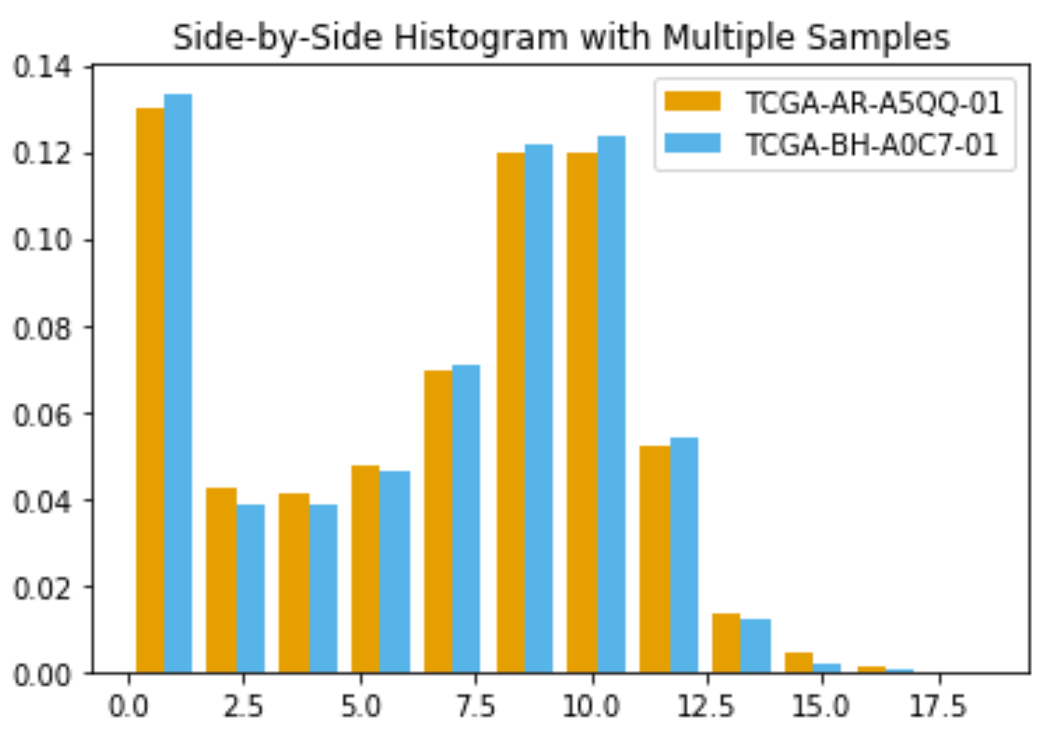
Side-by-side histograms!
Normalized # of genes
Log2(FPKM+1)
In ggplot2, use position=“dodge”

Slide 19
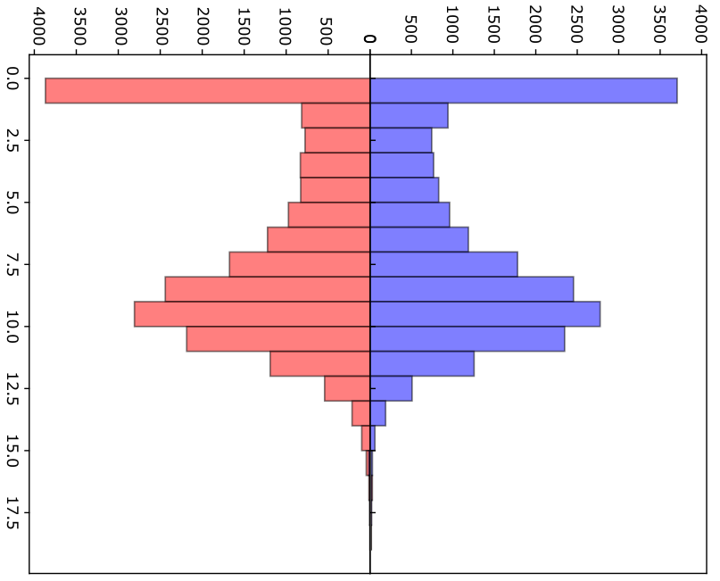
Another type of histogram for two distributions?
?
Normalized # of genes
# genes
Log2(FPKM+1)
Log2(FPKM+1)
Notes:
What do you think of this one then??

Slide 20
A new type of histogram to visualize distribution of multiple variables
Y-axis advances both directions
Can catch and compare the trend
Difficult to compare within each bin
Need to be careful to set the negative sign of y-axis right
# genes
Log2(FPKM+1)
Notes:
What do you think of this one then??

Slide 21
Similar: age pyramid plots
https://rpubs.com/chidungkt/505486

Slide 22
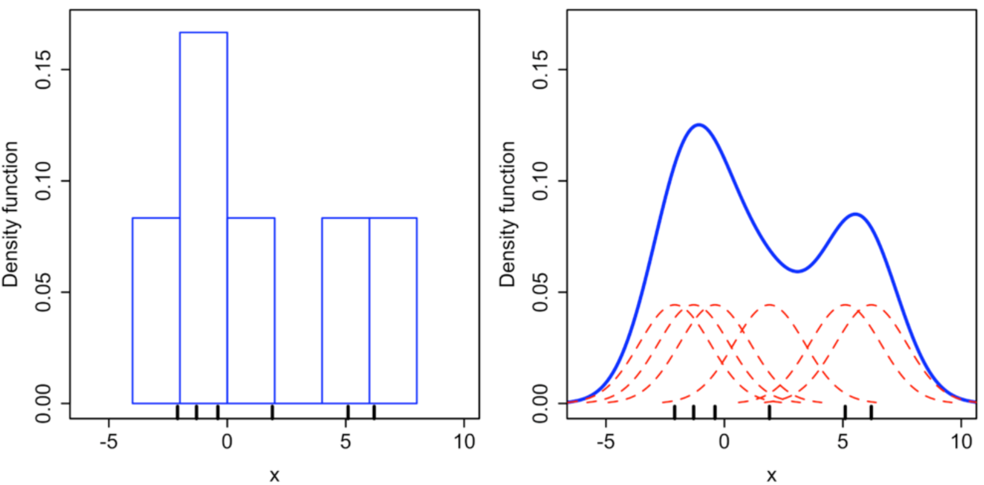
Density plots for visualizing probability distributions
Histogram vs. Density plot
E. g., X-axis values= {-2.05, -1.5, -0.1, 1.93, 5.2, 6.02}
Y-axis
The count in histogram
The probability density function different from a probability
Notes:
Here, each small black vertical line on the x-axis represents a data point. The individual kernels (Gaussians in this example) are shown drawn in dashed red lines above each point. The solid blue curve is created by summing the individual Gaussians and forms the overall density plot.
The x-axis is the value of the variable just like in a histogram, but what exactly does the y-axis represent? The y-axis in a density plot is the probability density function for the kernel density estimation. However, we need to be careful to specify this is a probability density and not a probability. The difference is the probability density is the probability per unit on the x-axis. To convert to an actual probability, we need to find the area under the curve for a specific interval on the x-axis. Somewhat confusingly, because this is a probability density and not a probability, the y-axis can take values greater than one. The only requirement of the density plot is that the total area under the curve integrates to one. I generally tend to think of the y-axis on a density plot as a value only for relative comparisons between different categories.
(https://towardsdatascience.com/histograms-and-density-plots-in-python-f6bda88f5ac0)
https://en.wikipedia.org/wiki/Kernel_density_estimation

Slide 23
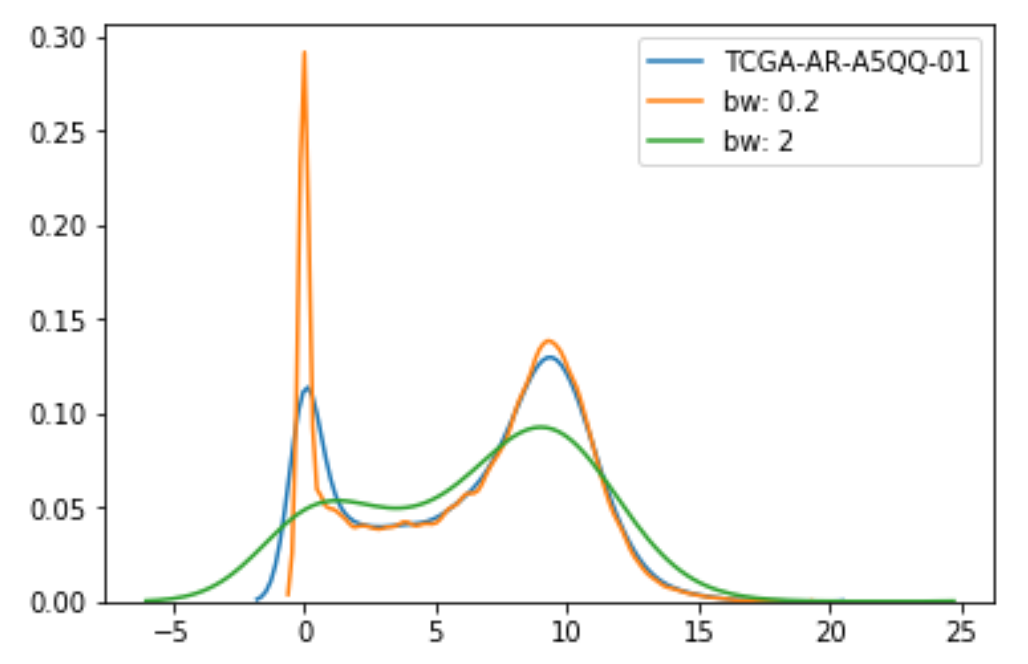
Bandwidth in density plot
Equivalent to bin width in a histogram, we need to find a good bandwidth in a density plot
ggplot2::geom_density
Similar aesthetics to geom_histogram
Essential parameters
kernel (default = gaussian)
bw = bandwidth = sd of kernel
bounds = upper/lower bounds for the estimated data
Density function
Log2(FPKM+1)
Notes:
Analogous to the binwidth of a histogram, a density plot has a parameter called the bandwidth that changes the individual kernels and significantly affects the final result of the plot. The plotting library will choose a reasonable value of the bandwidth for us (by default using the ‘scott’ estimate), and unlike the binwidth of a histogram, I usually use the default bandwidth. However, we can look at using different bandwidths to see if there is a better choice. In the plot, ‘scott’ is the default, which looks like the best option.

Slide 24
Density plots may yield unreasonable tails
Equivalent to bin width in a histogram, we need to
Find a good bandwidth in a density plot
Be careful of a tendency to produce the appearance of data when none exists
especially in the tails
can lead to figures that make nonsensical statements
use the “bounds” argument of geom_density
Density function
Log2(FPKM+1)
Notes:
Kernel density estimates have one pitfall that we need to be aware of: They have a tendency to produce the appearance of data where none exists, in particular in the tails. As a consequence, careless use of density estimates can easily lead to figures that make nonsensical statements. For example,
As we know, gene expression is a positive value. So after log transformation with plus 1, the minimum possible value is 0, which makes signals in this part unreasonable.

Slide 25
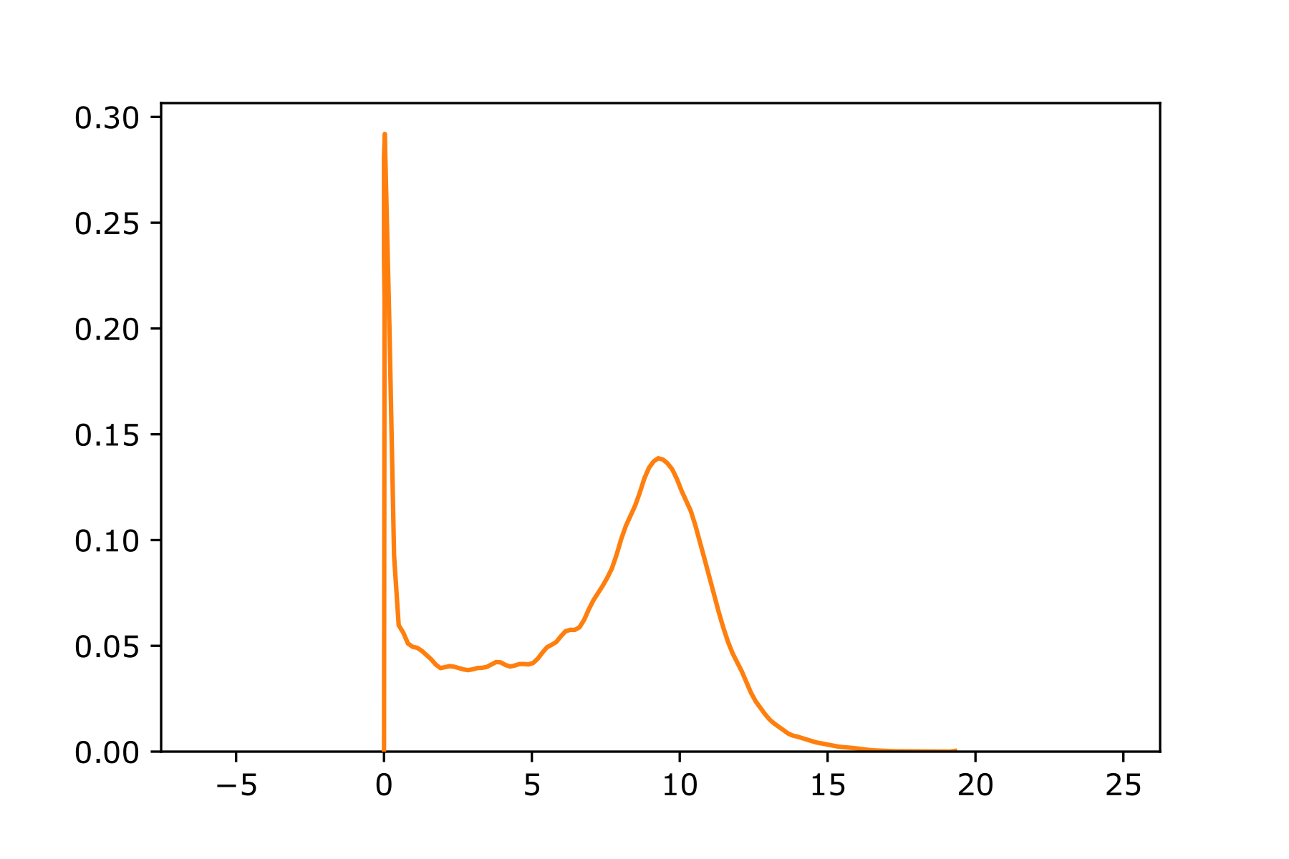
Density plots may yield unreasonable tails
Density function
Density function
Log2(FPKM+1)
Log2(FPKM+1)
Don’t just use an editor to remove the unreasonable tail.
Notes:
This is just an artifact of density estimation when we have a high bar around 0.

Slide 26
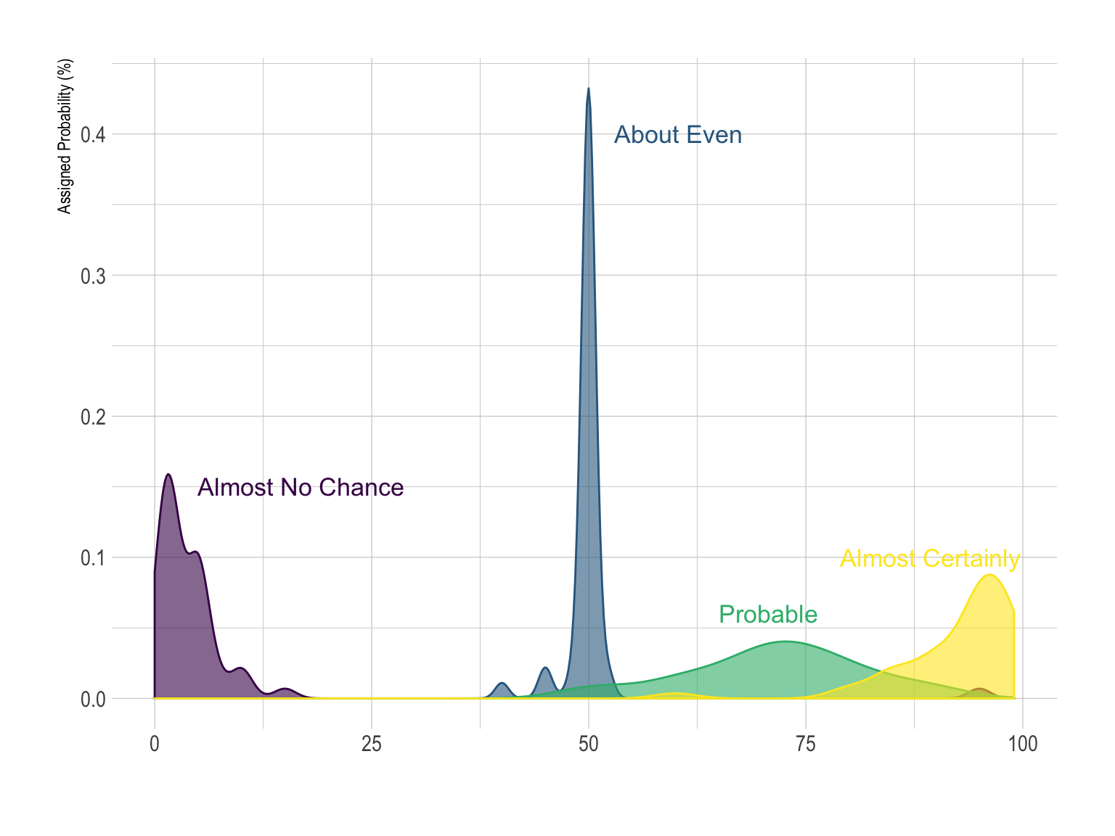
Density plot without unreasonable tails
How people perceive probability vocabulary
Fundamentals of Data Visualization, Wilke, O’Reilly, 1st Ed.
Notes:
Comparing the distributions of several numeric variables is a common task.
Here is an example showing how people perceive probability vocabulary. On the /r/samplesize thread of reddit, questions like What probability would you assign to the phrase “Highly likely” were asked. Here is the distribution of the score given by people to each question:
n this case, the figure is quite neat. People give a probability between 0 and 20% for the sentence “Almost No chance”, and between 75 and 100% for “Almost Certainly”. Let’s check what happens with more groups:

Slide 27
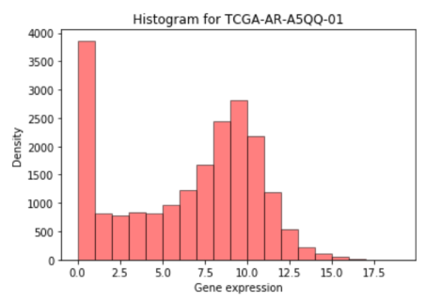
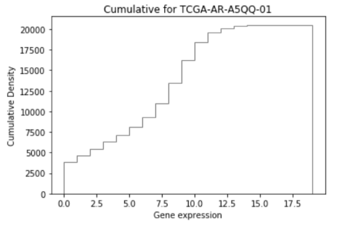
Visualizing cumulative distributions
The CDF is the function that says how much of the observed data (or pdf) is less than each given value.
F(x) = P[X <= x] for each possible value x.
(This is basically the integral of the histogram or pdf.)
In R, use the ecdf() function.

Slide 28
Visualizing cumulative distribution
Use CDF when you want to discuss how many observations fall in some interval
E.g., how many genes above ~2²? Above ~2⁷?
How many below 2²?
To answer this you can either
Add up the bins of the histogram
or subtract the two values of the CDF

Slide 29
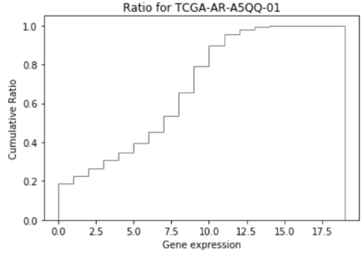
Cumulative distribution to visualize percentiles
3,030 genes express higher than 10 (log2 FPKM)
20% of the genes express higher than 10 (log2 FPKM)
Notes:
What can we do with

Slide 30
Inference from cumulative dist. is “indirect”
Q: Which figure is better for backing up the following statement?
?
20% of the genes express higher than 10 (log2 FPKM)

Slide 31
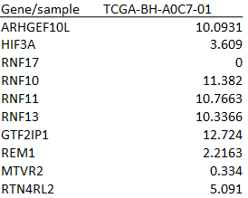
Cumulative dist’n. can be “indirect”
20% of the genes express higher than 10 (log2 FPKM)
…

Slide 32
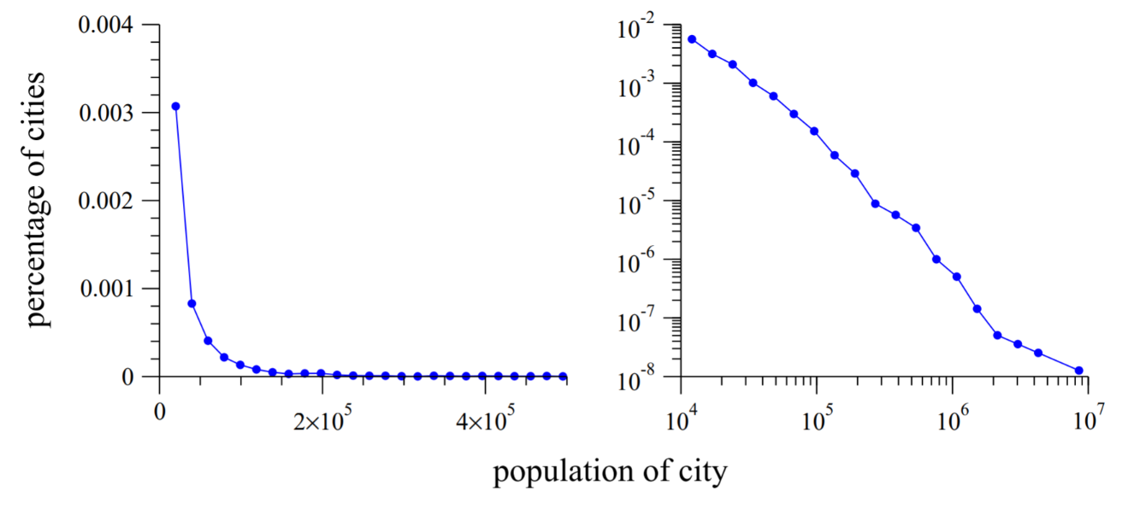
Visualization to reveal underlying statistical property
The populations of all US cities with population of 10,000 or more
Y-axis measures P[city > given pop’n.]
In other words, y = 1-CDF (on log scale)
http://www-personal.umich.edu/~mejn/courses/2006/cmplxsys899/powerlaws.pdf
Notes:
In the left panel of the figure, I show a simple histogram of the distribution of US city sizes. most US cities have small populations—there is a small number of cities with population much higher than the typical value, producing the long tail to the right of the histogram.
What is surprising on the other hand, is the right panel, which shows the histogram of city sizes again, but this time replotted with logarithmic horizontal and vertical axes. Now a remarkable pattern emerges: the histogram, when plotted in this fashion, follows quite closely a straight line. T

Slide 33
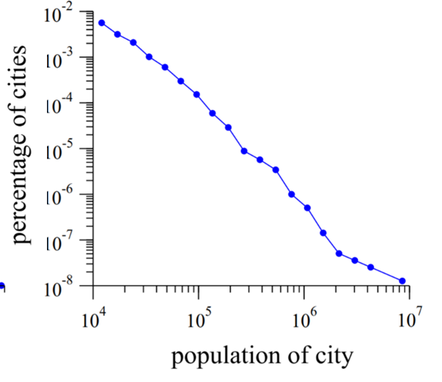
Distribution visualization to reveal underlying statistical property
The populations of all US cities
Suppose the CDF obeys an equation like this:
ln[1- F(x)] = −a ln x + b (as in the picture at the left)
Then the PDF obeys an equation like this:
f(x) = Cx^{−α} (the power law)
http://www-personal.umich.edu/~mejn/courses/2006/cmplxsys899/powerlaws.pdf
Notes:
Distributions of the form (1) are said to follow a power law. The constant α is called the exponent of the power law.

Slide 34
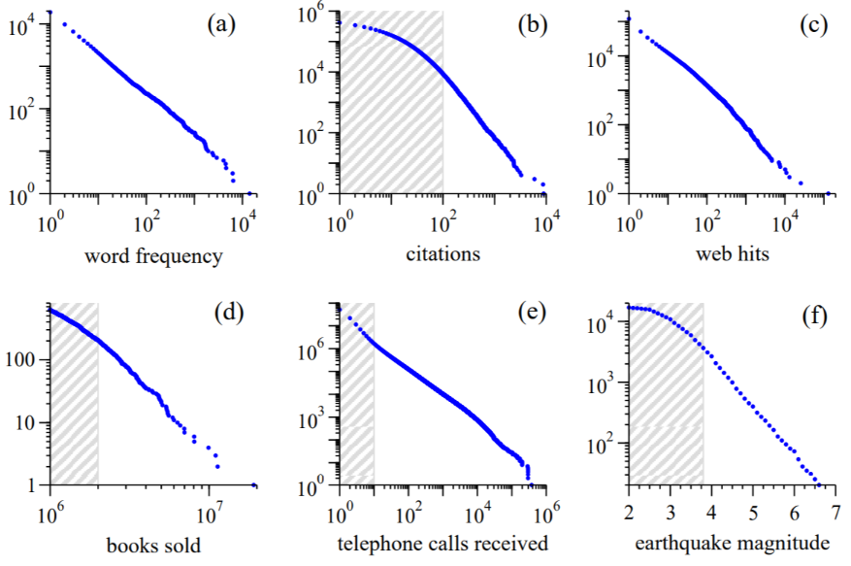
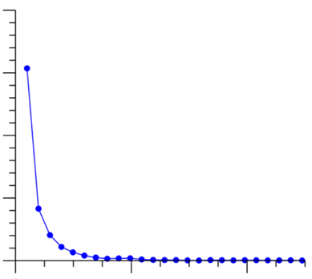
Some observed power laws
any human language
research papers
web sites
Published books
Phone numbers
Areas
http://www-personal.umich.edu/~mejn/courses/2006/cmplxsys899/powerlaws.pdf
Notes:
Power-law distributions occur in an extraordinarily diverse range of phenomena. In addition to city populations, the sizes of earthquakes [3], moon craters [4], solar flares [5], computer files [6] and wars [7], the frequency of use of words in any human language [2, 8], [9], the numbers of papers scientists write [10], the number of citations received by papers [11], the number of hits on web pages [12], [13, 14], the numbers of species in biological taxa [15], people’s annual incomes [16] and a host of other variables all follow power-law distributions

Slide 35
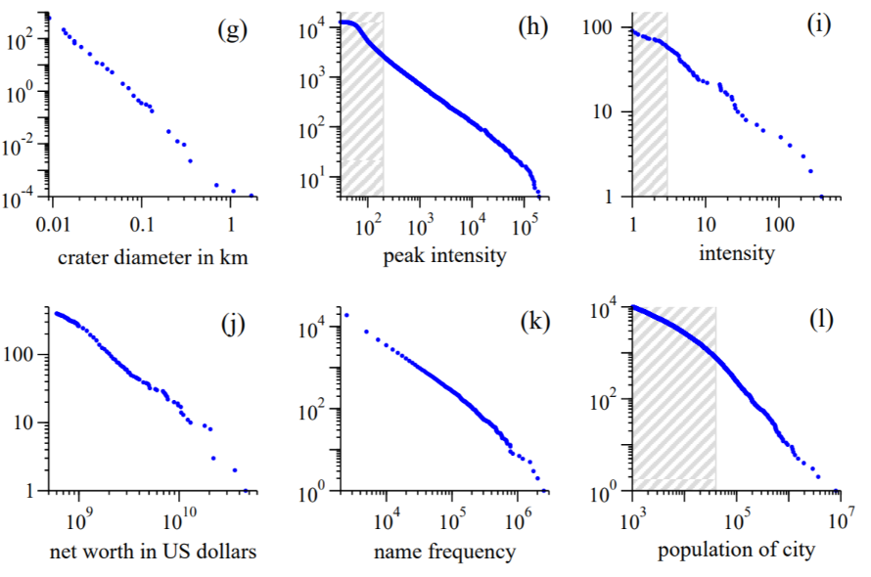
Some more observed power laws
Moon craters
Gamma ray in solar flares
Of wars b/w 1816 & 1980
Annual income
Family name in US
In terms of network nodes:
“rich-get-richer process”
Preferential attachment
http://www-personal.umich.edu/~mejn/courses/2006/cmplxsys899/powerlaws.pdf

Slide 36
Power laws appear in a ‘scale-free’ network that underwent preferential attachment
Preferential attachment
E. g.,
Calling frequency
Hits of web sites
Selling of published books
Citation of research papers
Use frequency of words in a language
Earthquake frequency across areas
https://medium.com/@pmontee/ventures-role-a-power-law-economy-and-society-f128f6691dc5

Slide 37
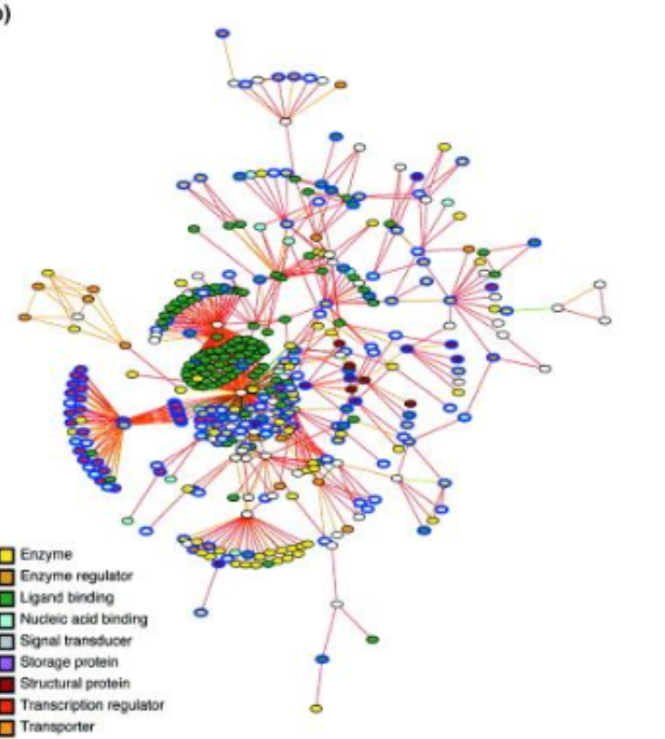
Typical look of scale-free networks
Predicted protein networks for E.coli.
McDermott J et al. Trends Biotechnol. (2004)

Slide 38
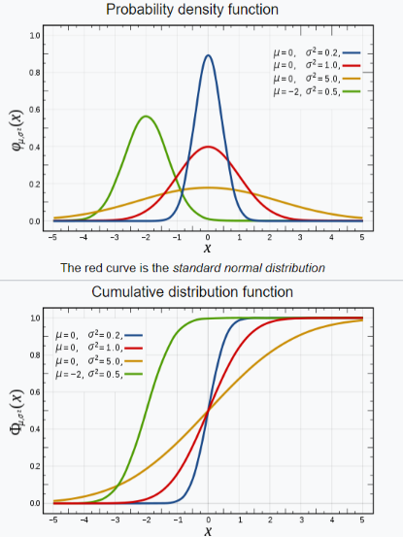
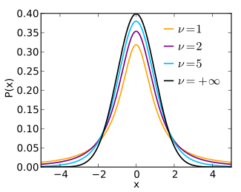
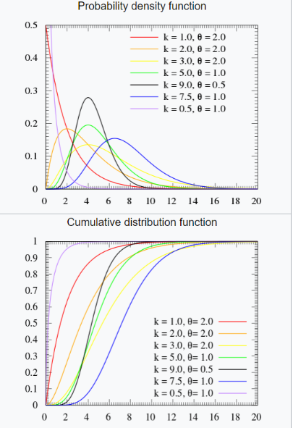
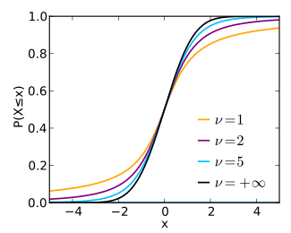
Some common probability distributions
Normal distribution
Student’s t distribution
Gamma distribution
https://en.wikipedia.org/wiki/Normal_distribution
https://en.wikipedia.org/wiki/Student%27s_t-distribution
https://en.wikipedia.org/wiki/Gamma_distribution
Notes:
Their importance is partly due to the central limit theorem. It states that, under some conditions, the average of many samples (observations) of a random variable with finite mean and variance is itself a random variable whose distribution converges to a normal distribution as the number of samples increases.

Slide 39
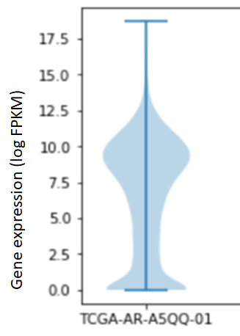
How to identify the underlying distribution?
Questions: to what extent does each follow
Normal distribution?
T-distribution
Gamma distribution?
Bimodal?
Notes:
When you deal with large data set, you are often interested in the relationship of the data set to a given distribution – is it consistent with the distribution? How do the tails compare?
For example, when you see this type of distribution, you ask if this follows normal distribution.

Slide 40
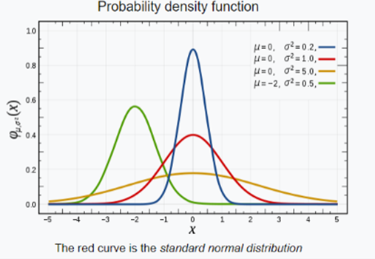
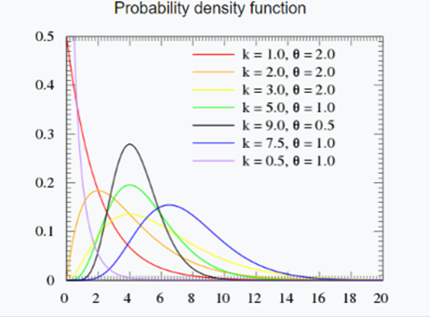
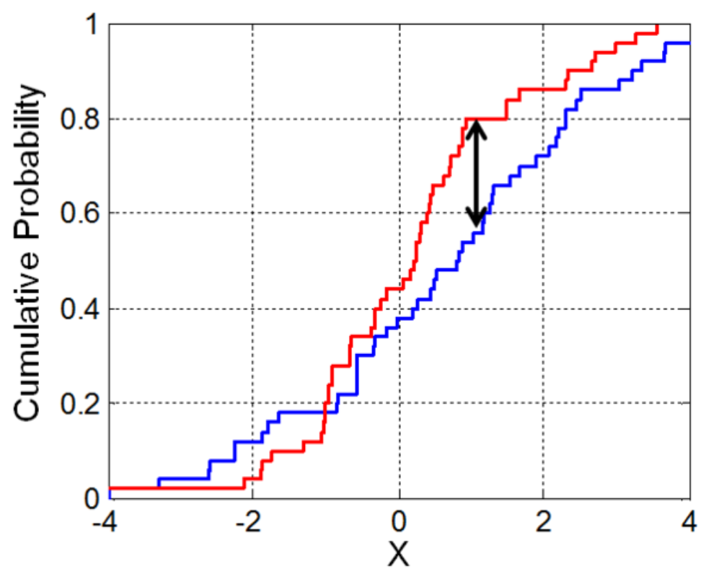
Some distributions may look quite alike
Normal distribution
Student’s t-distribution
Probably density function
Gamma
https://en.wikipedia.org/wiki/Kolmogorov%E2%80%93Smirnov_test

Slide 41
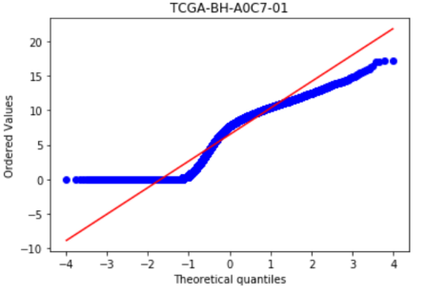
Quantile-quantile (Q-Q) plots compare your data’s distribution with a reference distribution (of your choice)
For a given reference distribution, you can always calculate quantiles
What would the smallest data point probably be?
The second smallest?
…
The biggest?
Plot the observed vs. theoretical quantiles
Points: x-coordinate represents the position in a reference distribution and y-coordinate represents the actual value
Diagonal line: where a given data point should fall if the data follows a specific reference distribution
TCGA-BH-A0C7-01 seems not to follow Gaussian
TCGA-BH-A0C7-01 for normal distribution
Smallest observed data value
Smallest expected data value (if you had generated the data from the reference dist’n.)
Notes:
Quantile–quantile (q-q) plots are a useful visualization when we want to determine to what extent the observed data points do or do not follow a given distribution. Just like ecdfs, q-q plots are also based on ranking the data and visualizing the relationship between ranks and actual values. However, in q-q plots we don’t plot the ranks directly, we use them to predict where a given data point should fall if the data were distributed according to a specified reference distribution.

Slide 42
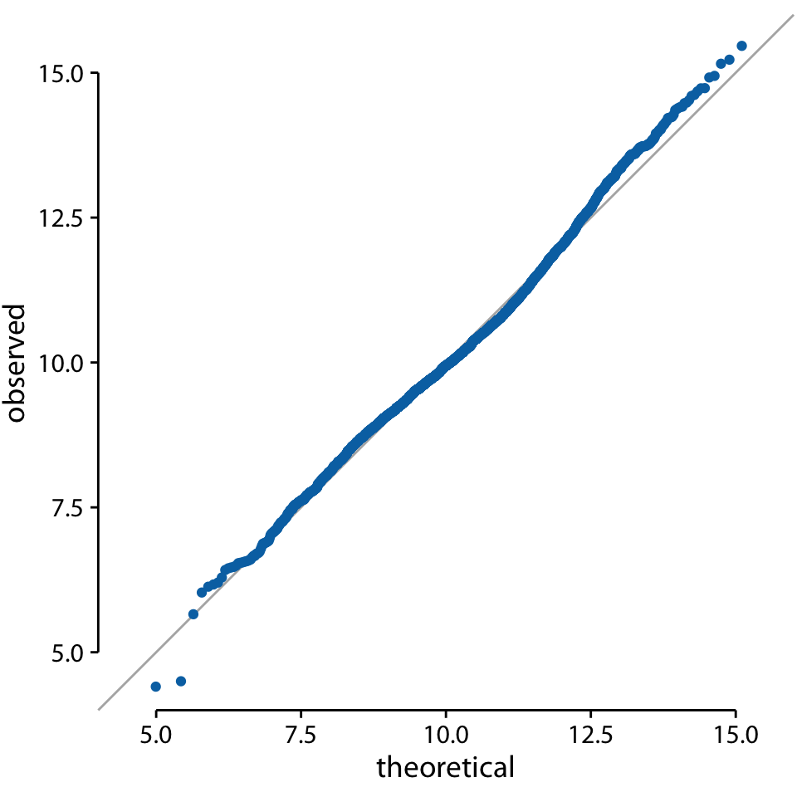
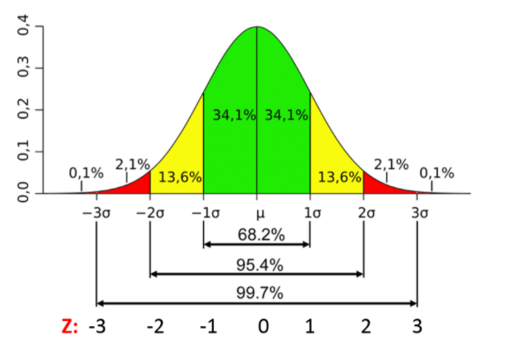
Quantile-quantile plot compares two dist’ns.
E.g. data ~ N(mean=10, sd=3)
E.g. 10 should be at the 50th percentile and 13 should be the 84.1th percentile (50+34.1)
https://sphweb.bumc.bu.edu/otlt/MPH-Modules/PH717-QuantCore/PH717-Module6-RandomError/PH717-Module6-RandomError5.html
0
25
50
75
100
Theoretical (normal, %)
Adapted from Fundamentals of Data Visualization, Wilke, O’Reilly, 1st Ed.
Notes:
Most commonly, q-q plots are constructed using a normal distribution as the reference. To give a concrete example, assume the actual data values have a mean of 10 and a standard deviation of 3. Then, assuming a normal distribution, we would expect a data point ranked at the 50th percentile to lie at position 10 (the mean), a data point at the 84th percentile to lie at position 13 (one standard deviation above from the mean), and a data point at the 2.3rd percentile to lie at position 4 (two standard deviations below the mean). We can carry out this calculation for all points in the dataset and then plot the observed values (i.e., values in the dataset) against the theoretical values (i.e., values expected given each data point’s rank and the assumed reference distribution).

Slide 43
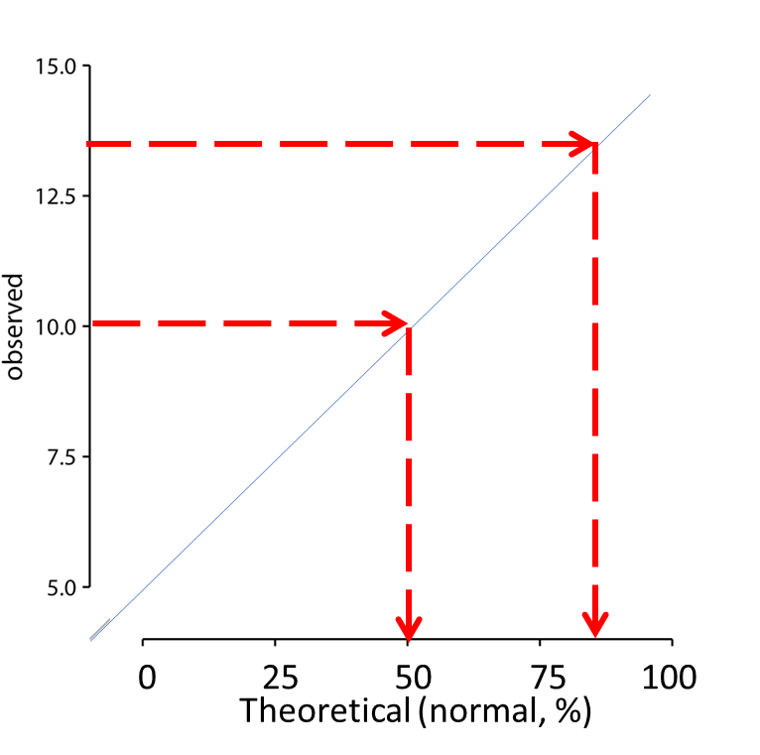
Quantile-quantile plot checks the association of the observed variable to a given distribution
E.g. 10 should be at the 50th percentile and 13 should be the 84.1th percentile (50+34.1)
E.g. In actual data, 10 is at the 50th percentile but 13 is stacked up lower than the 84.1th percentile due to a local value inflation
0
25
50
75
100
Theoretical (normal, %)
Adapted from Fundamentals of Data Visualization, Wilke, O’Reilly, 1st Ed.
Notes:
Then, assuming a normal distribution, we would expect a data point ranked at the 50th percentile to lie at position 10 (the mean), a data point at the 84th percentile to lie at position 13 (one standard deviation above from the mean), and a data point at the 2.3rd percentile to lie at position 4 (two standard deviations below the mean). We can carry out this calculation for all points in the dataset and then plot the observed values (i.e., values in the dataset) against the theoretical values (i.e., values expected given each data point’s rank and the assumed reference distribution).
However, since it is the visualization class, I might not have to go through theoretical explanation.

Slide 44
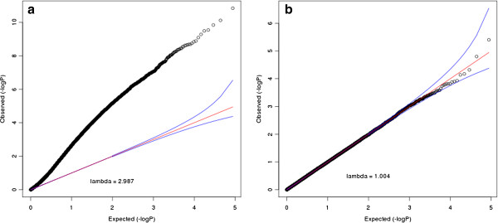
Quantile-quantile plot checks the association of the observed variable to a given distribution
Lambda quantifies how much it deviates from our expectation. Often want it to be roughly 1.
Notes:
Then, assuming a normal distribution, we would expect a data point ranked at the 50th percentile to lie at position 10 (the mean), a data point at the 84th percentile to lie at position 13 (one standard deviation above from the mean), and a data point at the 2.3rd percentile to lie at position 4 (two standard deviations below the mean). We can carry out this calculation for all points in the dataset and then plot the observed values (i.e., values in the dataset) against the theoretical values (i.e., values expected given each data point’s rank and the assumed reference distribution).
However, since it is the visualization class, I might not have to go through theoretical explanation.

Slide 45
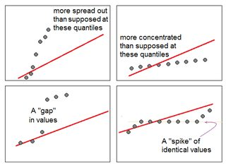
Local behavior in a quantile-quantile plot
https://stats.stackexchange.com/questions/101274/how-to-interpret-a-qq-plot
Notes:
Then, assuming a normal distribution, we would expect a data point ranked at the 50th percentile to lie at position 10 (the mean), a data point at the 84th percentile to lie at position 13 (one standard deviation above from the mean), and a data point at the 2.3rd percentile to lie at position 4 (two standard deviations below the mean). We can carry out this calculation for all points in the dataset and then plot the observed values (i.e., values in the dataset) against the theoretical values (i.e., values expected given each data point’s rank and the assumed reference distribution).
However, since it is the visualization class, I might not have to go through theoretical explanation.

Slide 46
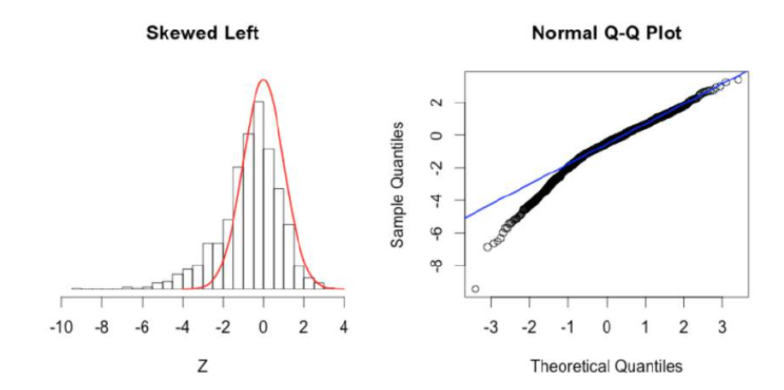
Skewness in normal quantile-quantile plot
https://towardsdatascience.com/q-q-plots-explained-5aa8495426c0
Notes:
Then, assuming a normal distribution, we would expect a data point ranked at the 50th percentile to lie at position 10 (the mean), a data point at the 84th percentile to lie at position 13 (one standard deviation above from the mean), and a data point at the 2.3rd percentile to lie at position 4 (two standard deviations below the mean). We can carry out this calculation for all points in the dataset and then plot the observed values (i.e., values in the dataset) against the theoretical values (i.e., values expected given each data point’s rank and the assumed reference distribution).
However, since it is the visualization class, I might not have to go through theoretical explanation.

Slide 47
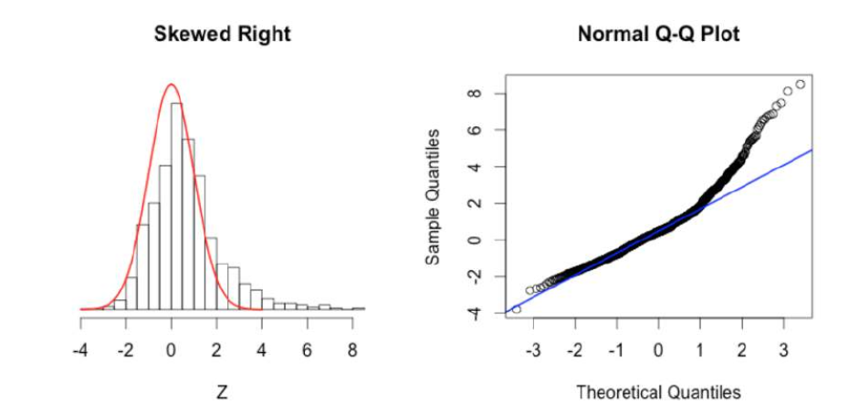
Skewness in normal quantile-quantile plot
https://towardsdatascience.com/q-q-plots-explained-5aa8495426c0
Notes:
Then, assuming a normal distribution, we would expect a data point ranked at the 50th percentile to lie at position 10 (the mean), a data point at the 84th percentile to lie at position 13 (one standard deviation above from the mean), and a data point at the 2.3rd percentile to lie at position 4 (two standard deviations below the mean). We can carry out this calculation for all points in the dataset and then plot the observed values (i.e., values in the dataset) against the theoretical values (i.e., values expected given each data point’s rank and the assumed reference distribution).
However, since it is the visualization class, I might not have to go through theoretical explanation.

Slide 48
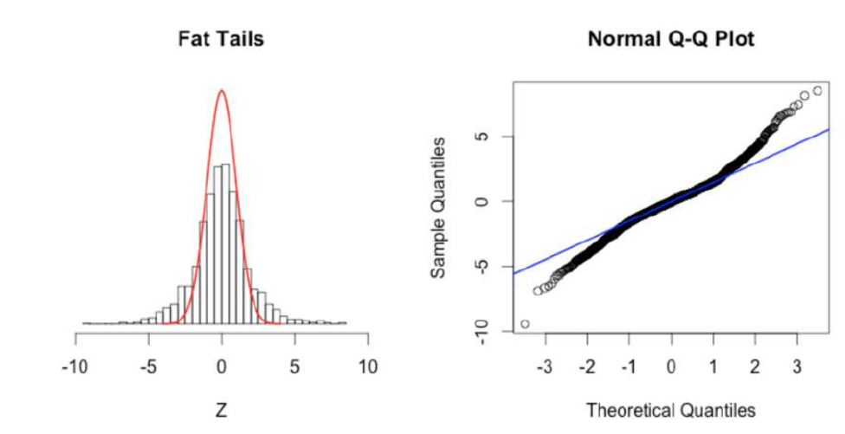
Fat tail in normal quantile-quantile plot
https://towardsdatascience.com/q-q-plots-explained-5aa8495426c0
Notes:
Then, assuming a normal distribution, we would expect a data point ranked at the 50th percentile to lie at position 10 (the mean), a data point at the 84th percentile to lie at position 13 (one standard deviation above from the mean), and a data point at the 2.3rd percentile to lie at position 4 (two standard deviations below the mean). We can carry out this calculation for all points in the dataset and then plot the observed values (i.e., values in the dataset) against the theoretical values (i.e., values expected given each data point’s rank and the assumed reference distribution).
However, since it is the visualization class, I might not have to go through theoretical explanation.

Slide 49
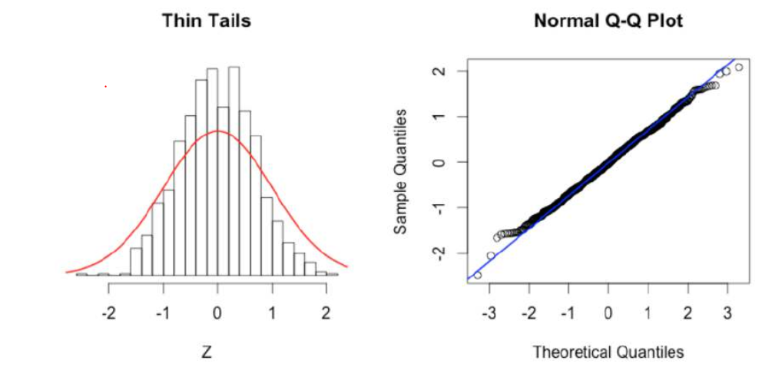
Light tail in normal quantile-quantile plot
https://towardsdatascience.com/q-q-plots-explained-5aa8495426c0
Notes:
Then, assuming a normal distribution, we would expect a data point ranked at the 50th percentile to lie at position 10 (the mean), a data point at the 84th percentile to lie at position 13 (one standard deviation above from the mean), and a data point at the 2.3rd percentile to lie at position 4 (two standard deviations below the mean). We can carry out this calculation for all points in the dataset and then plot the observed values (i.e., values in the dataset) against the theoretical values (i.e., values expected given each data point’s rank and the assumed reference distribution).
However, since it is the visualization class, I might not have to go through theoretical explanation.

Slide 50
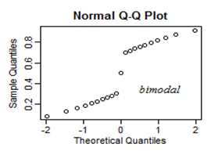
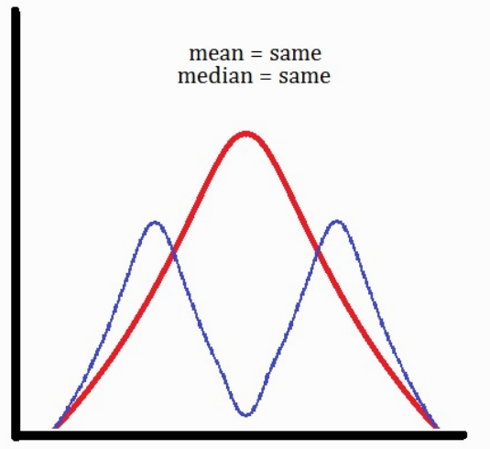
Bimodality in normal quantile-quantile plot
Adapted from https://stats.stackexchange.com/questions/101274/how-to-interpret-a-qq-plot & https://helenowskiirene.wordpress.com/tag/bimodal-distribution/
Notes:
Then, assuming a normal distribution, we would expect a data point ranked at the 50th percentile to lie at position 10 (the mean), a data point at the 84th percentile to lie at position 13 (one standard deviation above from the mean), and a data point at the 2.3rd percentile to lie at position 4 (two standard deviations below the mean). We can carry out this calculation for all points in the dataset and then plot the observed values (i.e., values in the dataset) against the theoretical values (i.e., values expected given each data point’s rank and the assumed reference distribution).
However, since it is the visualization class, I might not have to go through theoretical explanation.

Slide 51
Bimodality in normal quantile-quantile plot
Adapted from https://stats.stackexchange.com/questions/101274/how-to-interpret-a-qq-plot & https://helenowskiirene.wordpress.com/tag/bimodal-distribution/
Notes:
Then, assuming a normal distribution, we would expect a data point ranked at the 50th percentile to lie at position 10 (the mean), a data point at the 84th percentile to lie at position 13 (one standard deviation above from the mean), and a data point at the 2.3rd percentile to lie at position 4 (two standard deviations below the mean). We can carry out this calculation for all points in the dataset and then plot the observed values (i.e., values in the dataset) against the theoretical values (i.e., values expected given each data point’s rank and the assumed reference distribution).
However, since it is the visualization class, I might not have to go through theoretical explanation.

Slide 52
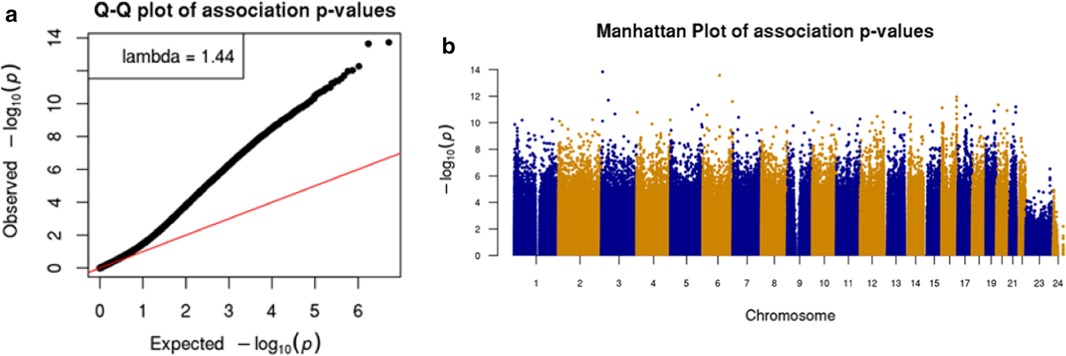
Quantile-quantile plot can be drawn for any distribution
Under the null hypothesis, p-values are uniformly distributed between 0 and 1
Cao et al. Clinical Epigenetics, 12, Article number: 192 (2020)
Notes:
Then, assuming a normal distribution, we would expect a data point ranked at the 50th percentile to lie at position 10 (the mean), a data point at the 84th percentile to lie at position 13 (one standard deviation above from the mean), and a data point at the 2.3rd percentile to lie at position 4 (two standard deviations below the mean). We can carry out this calculation for all points in the dataset and then plot the observed values (i.e., values in the dataset) against the theoretical values (i.e., values expected given each data point’s rank and the assumed reference distribution).
However, since it is the visualization class, I might not have to go through theoretical explanation.

Slide 53
How to tell the underlying distribution?
A quantitative way to describe the underlying distribution by looking at data?
Torrenté et al. BMC Bioinformatics, 2020

Slide 54
K-S test identifies a distribution in reference to the shape of theoretical distributions
Kolmogorov-Smirnov test
Test H₀ that data came from a specified null distribution
Uses distance between data’s eCDF the null CDF
P < 0.05 → reject H
Can be handy for “identifying” a distribution (i.e., a possibly good model)
Shapiro-Wilk test is specifically for testing normality
https://en.wikipedia.org/wiki/Kolmogorov%E2%80%93Smirnov_test

Slide 55
More plots for multiple distributions
Boxplots
Violin plots
Strip chart
Jittered strip charts
Beeswarm plots
Ridgeline plots
Notes:
After that, we will briefly discuss how to visualize amount, distributions, and proportions.

Slide 56
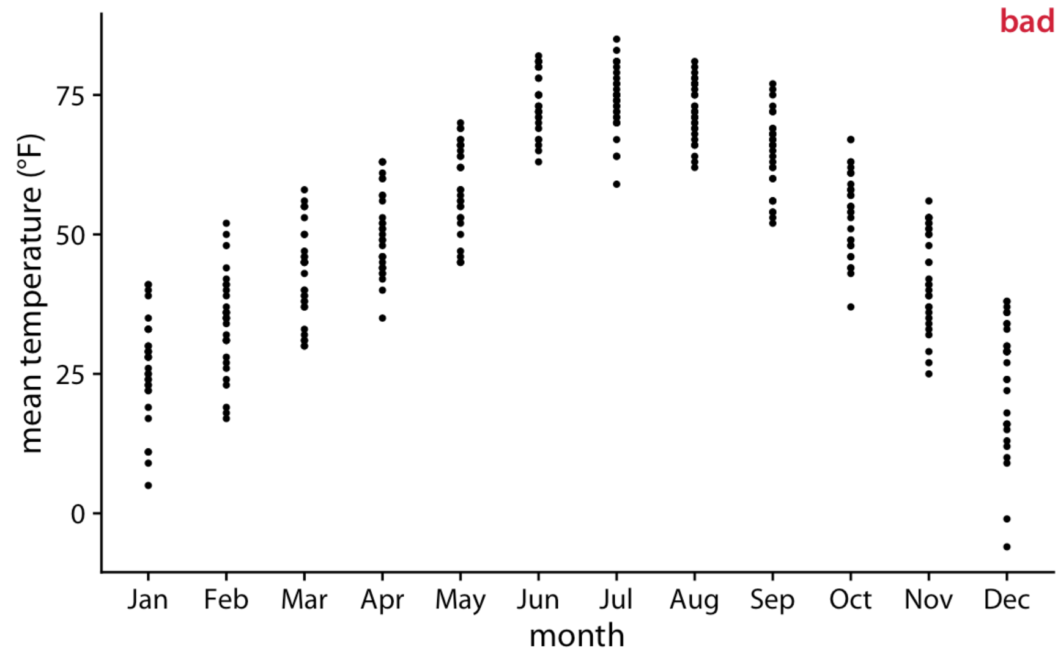
Many distributions in Strip chart
Monthly temperatures in Lincoln, Nebraska, in 2016
Pros: actual data instead of estimates
Cons: too many points lead to overplotting
Fundamentals of Data Visualization, Wilke, O’Reilly, 1st Ed.
Notes:
We can try to circumvent these issues by simply plotting all the individual data points directly, as dots (Figure 9.6). Such a figure is called a strip chart. Strip charts are fine in principle, as long as we make sure that we don’t plot too many points on top of each other.

Slide 57
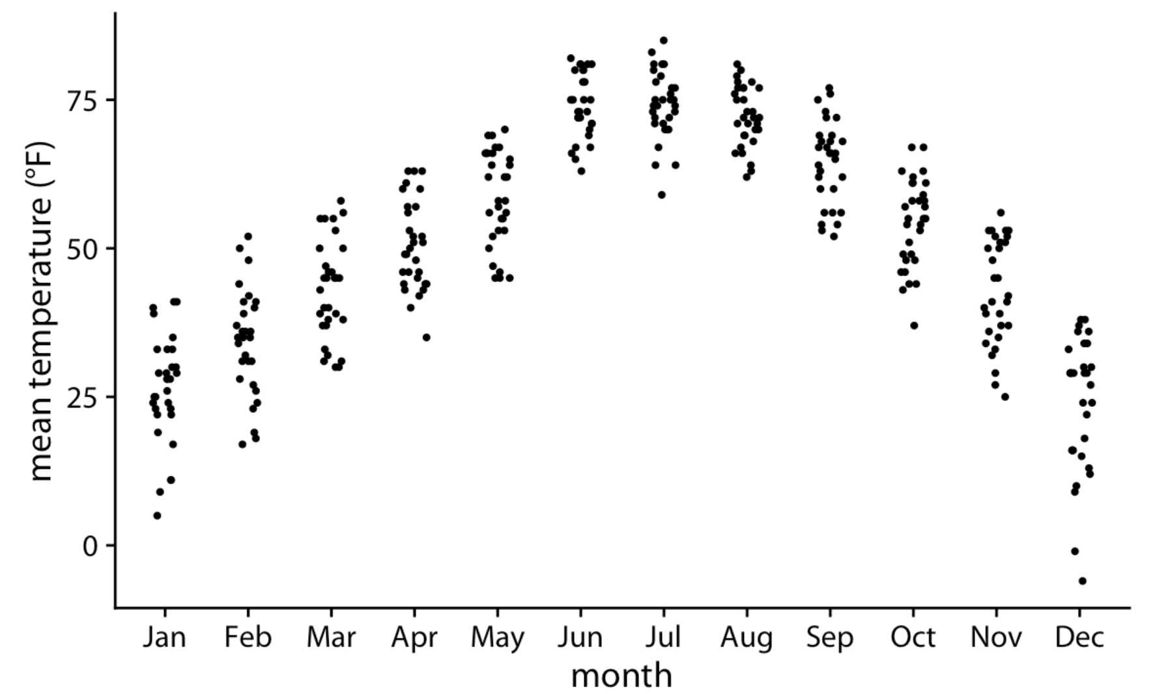
Many distributions in jittered strip chart
Monthly temperatures in Lincoln, Nebraska, in 2016
Jittering: slight irregular variation (< a constant)
Pros: solving the overplotting issue
Cons:
Changes the data
If too much, it will send the dots too far
Not easy to read multiple data points
Takes up space
Hard to see “density”
Fundamentals of Data Visualization, Wilke, O’Reilly, 1st Ed.
Notes:
A simple solution to overplotting is to spread out the points somewhat along the x axis, by adding some random noise in the x dimension (Figure 9.7). This technique is also called jittering.
One downside of jittering is that it does change the data and therefore has to be performed with care. If we jitter too much, we end up placing points in locations that are not representative of the underlying dataset. The result is a misleading visualization of the data. See Figure 18.4 as an example.

Slide 58
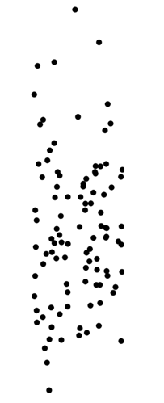
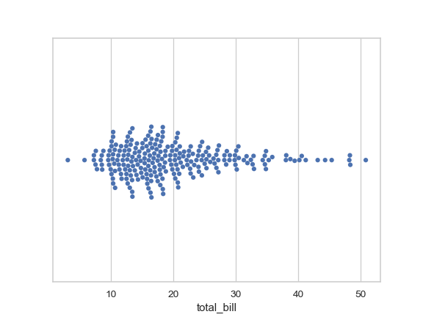
Many distributions in (bee)swarm plot
Data in variable
Data in variable
Pros: helps you to see actual distribution over y-axis
Pros: more efficient than jittered strip chart
Cons: still non-data visualization along x-axis
Temperature
July
https://seaborn.pydata.org/generated/seaborn.swarmplot.html
Notes:
Instead of jittering which is random noise, you can also align the points in a more meaningful way.
When you align the points such that those with similar y-axis value are together, you can see the distribution more clearly.
Which is

Slide 59

Not ideal for too many variables
404 data points for 36 clinical features
Same with the plots showing actual data (e.g. jittered strip chart)
Time to use plots showing statistical properties, e.g. boxplot and violinplot
Unpublished

Slide 60

Distribution in boxplot
Data in variable
Descriptive statistics of data
=Q3+1.5*IQR
Q3
Temperature
IQR (Interquartile region)
Q1
=Q1-1.5*IQR
July
Adapted from Fundamentals of Data Visualization, Wilke, O’Reilly, 1st Ed.
Notes:
Let’s say that the values in the rectangle in the previous slide are here.
Anatomy of a boxplot. Shown are a cloud of points (left) and the corresponding boxplot (right). Only the y values of the points are visualized in the boxplot. The line in the middle of the boxplot represents the median, and the box encloses the middle 50% of the data. The top and bottom whiskers extend either to the maximum and minimum of the data or to the maximum or minimum that falls within 1.5 times the height of the box, whichever yields the shorter whisker. The distances of 1.5 times the height of the box in either direction are called the upper and the lower fences. Individual data points that fall beyond the fences are referred to as outliers and are usually showns as individual dots.

Slide 61

Many distributions in Boxplot
With median, IQR, and whiskers, can easily read patterns in the multiple distributions. e.g.
Skewness in December
No skewness in July
Monthly temperatures in Lincoln, Nebraska, in 2016
Fundamentals of Data Visualization, Wilke, O’Reilly, 1st Ed.
Notes:
With more distribution data, the difference becomes more clear.
In that figure, we can now see that temperature is highly skewed in December (most days are moderately cold and a few are extremely cold) and not very skewed at all in some other months, for example in July.

Slide 62

Boxplot helps us see multiple aspects of data
Values of usual interest
Median
e.g. monotonical increase
IQR
e.g. words with large/small IQR
Skewness
e.g. Better Than Even
Outliers
e.g. words with many/few outliers
Raw data can be overlaid!
Fundamentals of Data Visualization, Wilke, O’Reilly, 1st Ed.

Slide 63

Violin plots
Data in variable
Density estimation of data
Boxplots replaced by violin plots
Pros
More nuanced picture
Cons
Estimation, not data
Lower probability
Temperature
Higher probability
Lower probability
July
Adapted from Fundamentals of Data Visualization, Wilke, O’Reilly, 1st Ed.
Notes:
Therefore, more recently, we see boxplots being replaced by violin plots, which are equivalent to the density estimates. Violins can be used whenever one would otherwise use a boxplot, and they provide a much more nuanced picture of the data.

Slide 64

Many distributions in Violin plot
Monthly temperatures in Lincoln, Nebraska, in 2016
Pros: show distribution shape
e. g., unimodal vs. bimodal
Cons: does not show summary statistics, difficult to compare
Fundamentals of Data Visualization, Wilke, O’Reilly, 1st Ed.
Notes:
When we visualize the Lincoln temperature data with violins, we obtain Figure 9.5. We can now see that some months do have moderately bimodal data. For example, the month of November seems to have had two temperature clusters, one around 50 degrees and one around 35 degrees Fahrenheit.
Because violin plots are derived from density estimates, they have similar shortcomings (Chapter 7). In particular, they can generate the appearance that there is data where none exists, or that the data set is very dense when actually it is quite sparse.

Slide 65
Distribution in violin plot
Data in variable
Density estimation of data
Boxplots replaced by violin plots
Pros
More nuanced picture
Cons
Largely estimation, not data
Lower probability
Third quartile
Temperature
Median
Higher probability
First quartile
Lower probability
July
Adapted from Fundamentals of Data Visualization, Wilke, O’Reilly, 1st Ed.
Notes:
Therefore, more recently, we see boxplots being replaced by violin plots, which are equivalent to the density estimates. Violins can be used whenever one would otherwise use a boxplot, and they provide a much more nuanced picture of the data.

Slide 66

Distribution with different sample size has different statistical power
Between the shape of B and C, which would you be more confident about?
To estimate the statistical power, annotate sample size whenever possible
https://www.data-to-viz.com/caveat/boxplot.html
Notes:
However, their statistical power might not be all equal with respect to the sample size from which to draw each.
For example, we are more confident about bimodality of group B than unimodali distribution of group C.
In that sense, it is important to clearly annotate the sample size in the figure.
On the previous chart, the sample size of each group is indicated on the x-axis, below the group name. This is a good practice and shows that group C is under-represented.

Slide 67

Violinplot with sample size
Between the shape of B and C, which would you be more confident about?
To estimate the statistical power, annotate sample size whenever possible
https://www.data-to-viz.com/caveat/boxplot.html
Notes:
To visualize the effect of the sample size more clearly, we can also visualize sample size as follows.
However, it is sometimes better to show the data points themselves. Thus, a good alternative is a half violin plot showing the raw data. This uses code coming from jbburant and David Robinson.

Slide 68



Data visualization with sample size
P=1.7e⁻⁵⁴
Zhenjiang et al. In revision
Notes:
However, their statistical power might not be all equal with respect to the sample size from which to draw each.
For example, we are more confident about bimodality of group B than unimodali distribution of group C.
In that sense, it is important to clearly annotate the sample size in the figure.
On the previous chart, the sample size of each group is indicated on the x-axis, below the group name. This is a good practice and shows that group C is under-represented.

Slide 69

Many distributions in jittered strip chart and violin plot
Monthly temperatures in Lincoln, Nebraska, in 2016
Hybrid of
violin and jittered strip (a.k.a. sina plot)
violin and box plot
Fundamentals of Data Visualization, Wilke, O’Reilly, 1st Ed.
Notes:
Finally, we can combine the best of both worlds by spreading out the dots in proportion to the point density at a given y coordinate. This method, called a sina plot (Sidiropoulos et al. 2018), can be thought of as a hybrid between a violin plot and jittered points, and it shows each individual point while also visualizing the distributions. I have here drawn the sina plots on top of the violins to highlight the relationship between these two approaches (Figure 9.8).

Slide 70

Histogram is not ideal for distributions over many variables
Monthly temperatures in Lincoln, Nebraska, in 2016
Cons: the vertical lines running together
Solution:
Spread the variables
A visualization that doesn’t require vertical lines to be drawn
Fundamentals of Data Visualization, Wilke, O’Reilly, 1st Ed.
Notes:
In principle, we can use histograms instead of density plots in a ridgeline visualization. However, the resulting figures often don’t look very good (Figure 9.10).
This figure shows the distributions of monthly temperatures in Lincoln, Nebraska, in 2016.
The problems are similar to those of stacked or overlapping histograms (Chapter 7). Because the vertical lines in these ridgeline histograms appear always at the exact same x values, the bars from different histograms align with each other in confusing ways. In my opinion, it is better to not draw such overlapping histograms.

Slide 71

Many distributions in ridgeline plot
Density estimates like violin plot with x-axis showing the data values and the y-axis showing the variables
Pros: work well to show trends in distributions across variables (e. g., over time)
Overlap usually discouraged to use, but maybe OK with estimate visualization
Monthly temperatures in Lincoln, Nebraska, in 2016
Fundamentals of Data Visualization, Wilke, O’Reilly, 1st Ed.
Notes:
the x axis shows the response variable and the y axis shows the grouping variable, there is no separate axis for the density estimates in a ridgeline plot. Density estimates are shown alongside the grouping variable. This is no different from the violin plot, where densities are also shown alongside the grouping variable, without a separate, explicit scale. In both cases, the purpose of the plot is not to show specific density values but instead to allow for easy comparison of density shapes and relative heights across groups.
The resulting visualization is called a ridgeline plot, because these plots look like mountain ridgelines. Ridgeline plots tend to work particularly well if want to show trends in distributions over time.
The standard ridgeline plot uses density estimates (Figure 9.9). It is quite closely related to the violin plot, but frequently evokes a more intuitive understanding of the data. For example, the two clusters of temperatures around 35 degrees and 50 degrees Fahrenheit in November are much more obvious in Figure 9.9 than in Figure 9.5.
Because

Slide 72

Ridgeline plot for very large numbers of distributions
The distributions of movie lengths
Pros: scale to very large numbers of distributions, because it saves space compared to boxplot assuming gradual changes between neighboring variables
Fundamentals of Data Visualization, Wilke, O’Reilly, 1st Ed.
Notes:
Ridgeline plots scale to very large numbers of distributions. For example, Figure 9.11 shows the distributions of movie lengths from 1913 to 2005. This figure contains almost 100 distinct distributions and yet it is very easy to read. We can see that in the 1920s, movies came in many different lengths, but since about 1960 movie length has standardized to approximately 90 minutes.

Slide 73

Ridgeline plot to compare many distributions
Can compare two trends over times (color being another dimension)
DW-NOMINATE scores shows voting patterns of the party congressmen.
Expansion of ideological divides in Congress
Fundamentals of Data Visualization, Wilke, O’Reilly, 1st Ed.
Notes:
Ridgeline plots also work well if we want to compare two trends over time. This is a scenario that arises commonly if we want to analyze the voting patterns of the members of two different parties. We can make this comparison by staggering the distributions vertically by time and drawing two differently colored distributions at each time point, representing the two parties (Figure 9.12).
the expansion of ideological divides in Congress, which has spurred intense partisanship between Republicans and Democrats in recent decades.

